Slide 1
Touching the CLOUD
Angajatorii de top - Timisoara
October 2018

Slide 2
agenda
Notes:
1

Slide 3
Distributed systems
Notes:
1

Slide 4
What is cloud
Notes:
1

Slide 5
Why cloud
Notes:
1

Slide 6
Where is cloud
Notes:
1

Slide 7
Cloud evolution
Notes:
1

Slide 8
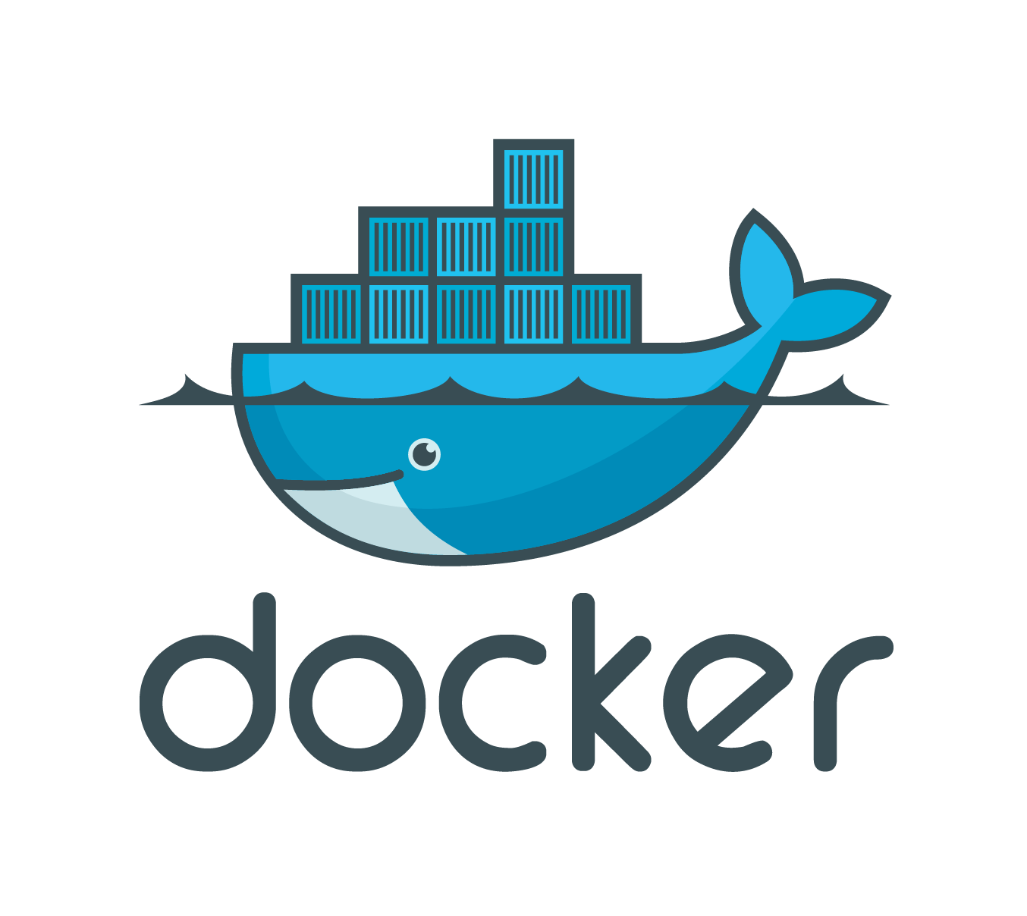
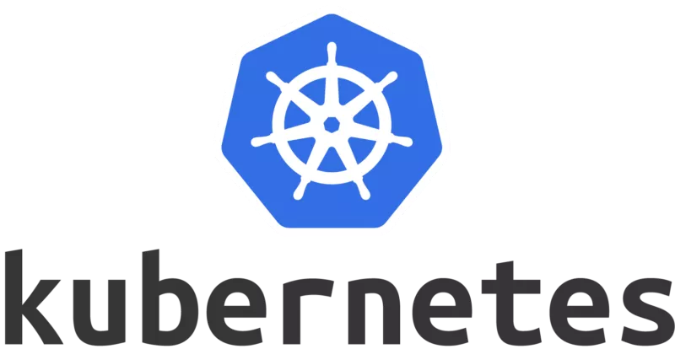

What is openshift
What is Openshift
+
=
Notes:
1

Slide 9
Openshift advantages
Notes:
1

Slide 10
Live coding
Notes:
1

Slide 11
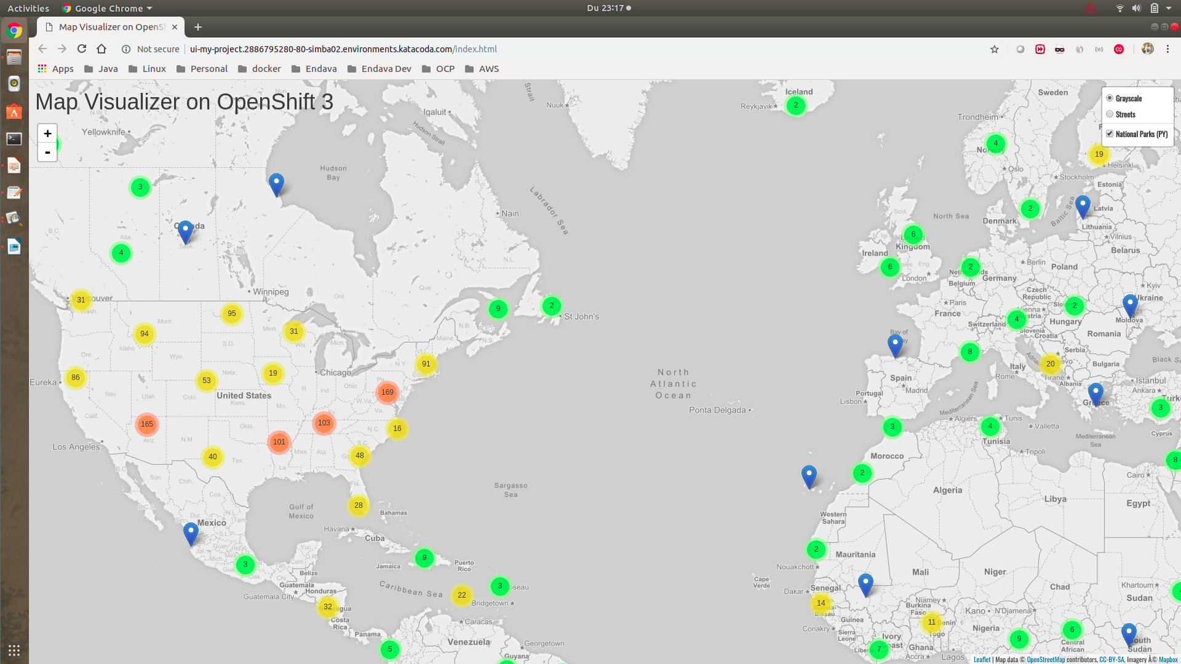
Notes:
1

Slide 12

Serverless computing
What is serverless computing
Build and run applications without thinking about servers
Why use serverless computing?
Developers can focus on their core product instead of worrying about
managing and operating servers or runtimes
Benefits of serverless computing
* no server management
* flexible scaling
* automated high availability
* costs
Notes:
1

Slide 13

Start from vision
A computer on every desk and in every home running Microsoft software
Bill Gates 1980
Transform any book or article into audio even if is in another language
Notes:
1

Slide 14

Amazon polly
Turn text into lifelike speech using deep learning
Benefits
* NATURAL SOUNDING VOICES
* STORE & REDISTRIBUTE SPEECH
* REAL-TIME STREAMING
* CUSTOMIZE & CONTROL SPEECH OUTPUT
* LOW COST
Notes:
1

Slide 15
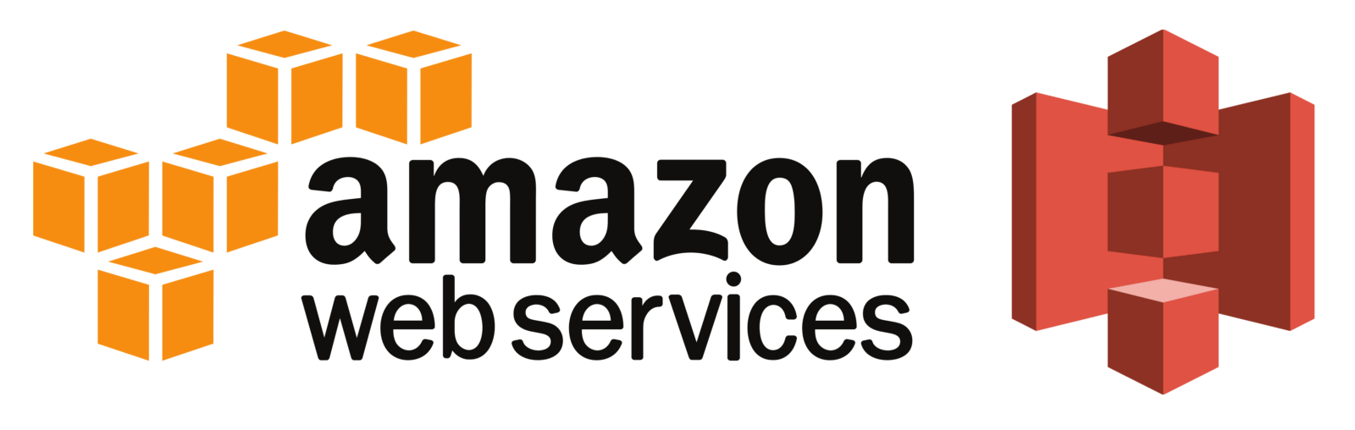
Amazon S3 storage
Object storage built to store and retrieve any amount of data from anywhere
Benefits
* Unmatched durability, availability and scalability
* comprehensive security and compliance capabilities
* query in place
* flexible management
* most supported by partners, vendors and AWS services
* easy, flexible data transfer
Use cases
* backup and recovery
*data archiving
* data lake and big data analytics
* hybrid cloud storage
* cloud native applications
* disaster recovery
Notes:
1

Slide 16
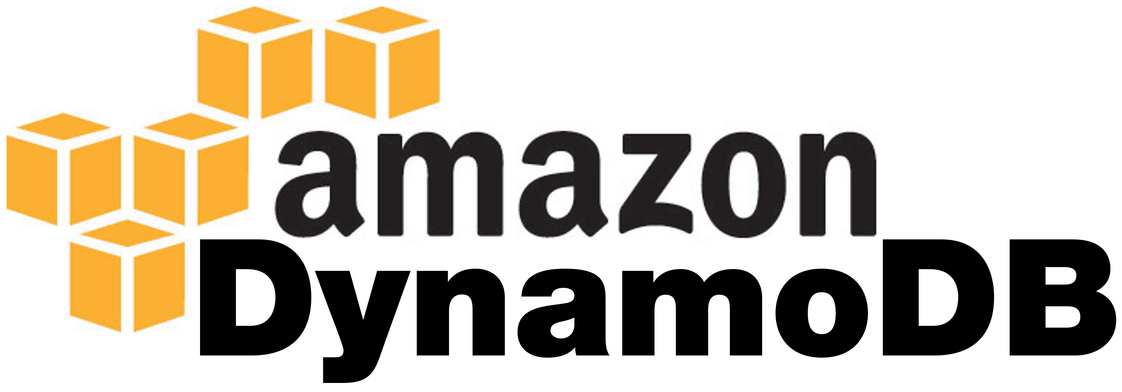
Dynamo db
Amazon DynamoDB is a nonrelational database that delivers reliable
performance at any scale.
Create a new table for your application and let DynamoDB handle the rest.
Benefits
PERFORMANCE AT SCALE
FULLY MANAGED
ENTERPRISE-READY
Notes:
1

Slide 17

lambda
Run code without thinking about servers. Pay only for the compute time
you consume.
Benefits
NO SERVERS TO MANAGE
CONTINUOUS SCALING
SUBSECOND METERING
Notes:
1

Slide 18

Api gateway
Create, maintain, and secure APIs at any scale
An API that acts as a “front door” for applications to access data,
business logic, or functionality from your back-end servicesand the
amount of data transferred out.
Benefits
LOW COST AND EFFICIENT
PERFORMANCE AT ANY SCALE
EASILY MONITOR API ACTIVITY
STREAMLINE API DEVELOPMENT
FLEXIBLE SECURITY CONTROLS
RUN YOUR APIS WITHOUT SERVERS
CREATE RESTFUL API ENDPOINTS FOR EXISTING SERVICES
Notes:
1

Slide 19

Sns component
Decouple and scale microservices, distributed systems, and serverless
applications
With SNS, you can use topics to decouple message publishers from
subscribers, fan-out messages to multiple recipients at once,
and eliminate polling in your applications.
SNS supports a variety of subscription types, allowing you to push
messages directly to Amazon Simple Queue Service (SQS) queues,
AWS Lambda functions, and HTTP endpoints.
Notes:
1

Slide 20
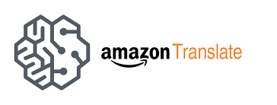
Aws translate
Natural and accurate language translation
neural machine translation service that delivers:
fast,
high-quality,
and affordable language translation
Benefits
Highly Accurate & Continuously Learning
Easy to Integrate into Your Applications
Scalable
Notes:
1

Slide 21
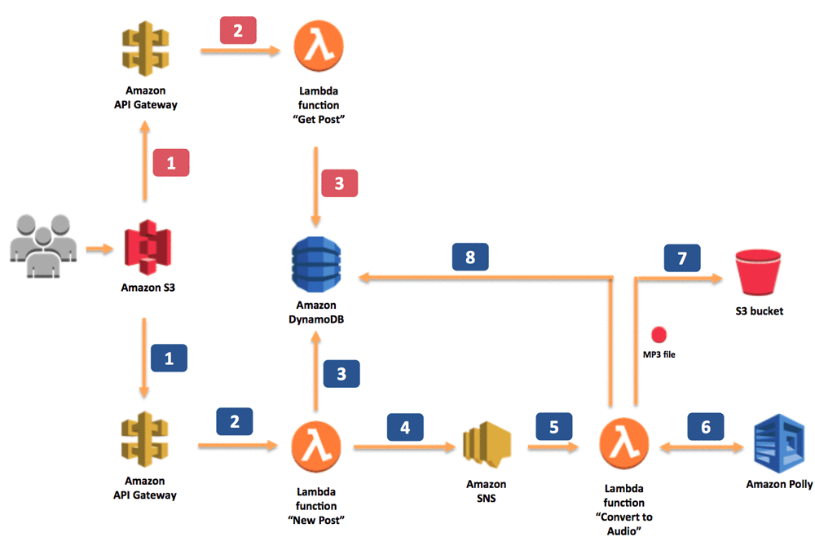
text to speech architecture
Notes:
1

Slide 22
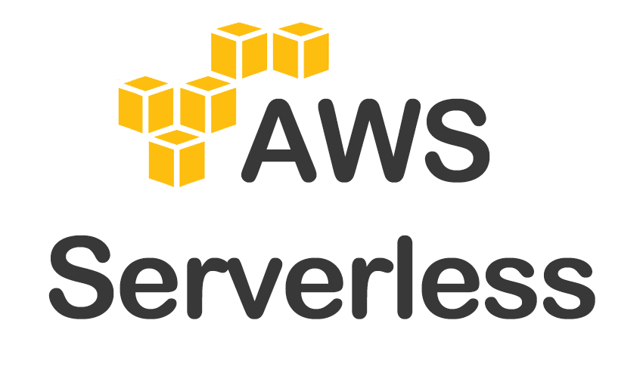
Live coding
Notes:
1

Slide 23
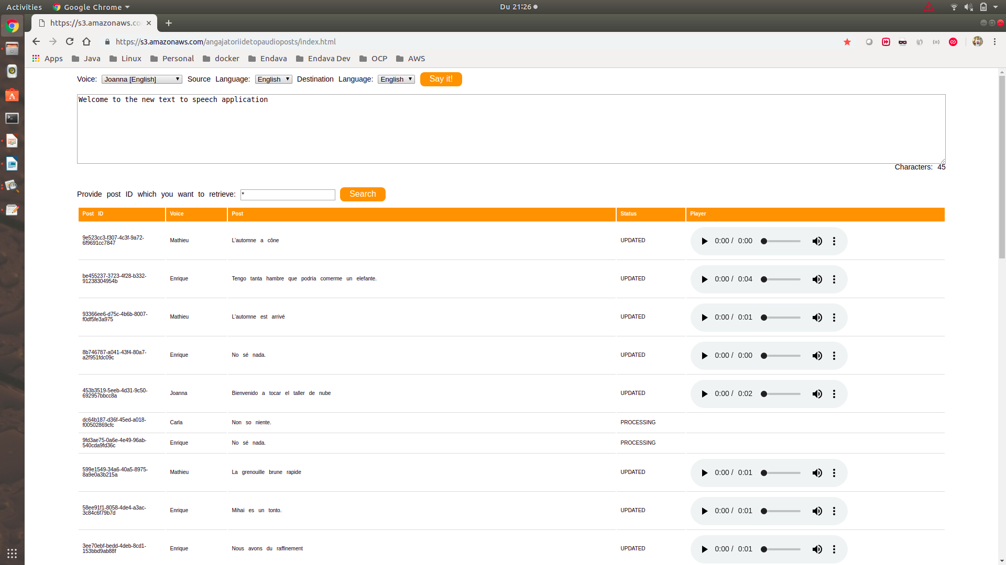
Notes:
1

Slide 24

Next steps
Real time translator
Convert real time audio into another language audio
;
Could be a very good fit to IoT: smart headset, smartphone app,etc
Amazon Transcribe is an automatic speech recognition (ASR) service
that makes it easy for developers to add speech-to-text capability to
their applications.
Key Features
Easy-to-Read Transcriptions
Recognize Multiple Speakers
Channel Identification
Notes:
1

Slide 25
review
Notes:
<number>

Slide 26
Why you should learn cloud
Notes:
<number>

Slide 27


Slide 28
THANK YOU
MIHAI STANGACIU
DEVELOPMENT LEAD
Mihai.Stangaciu@endava.com

